Slide 2
Why a Grade Calculator Web Application?

Slide 3


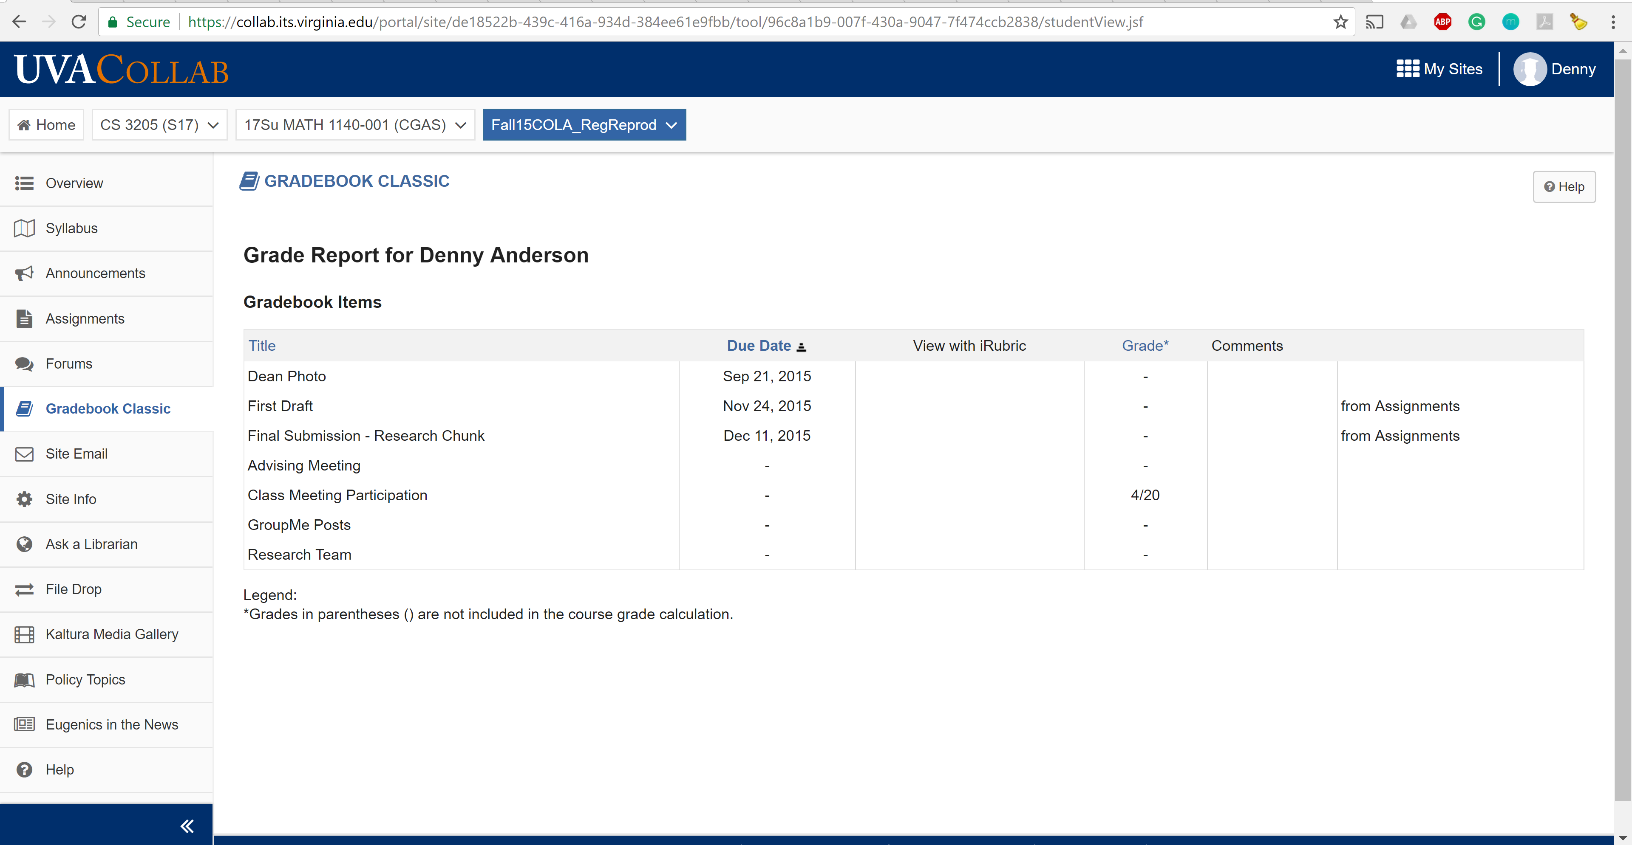




Slide 4
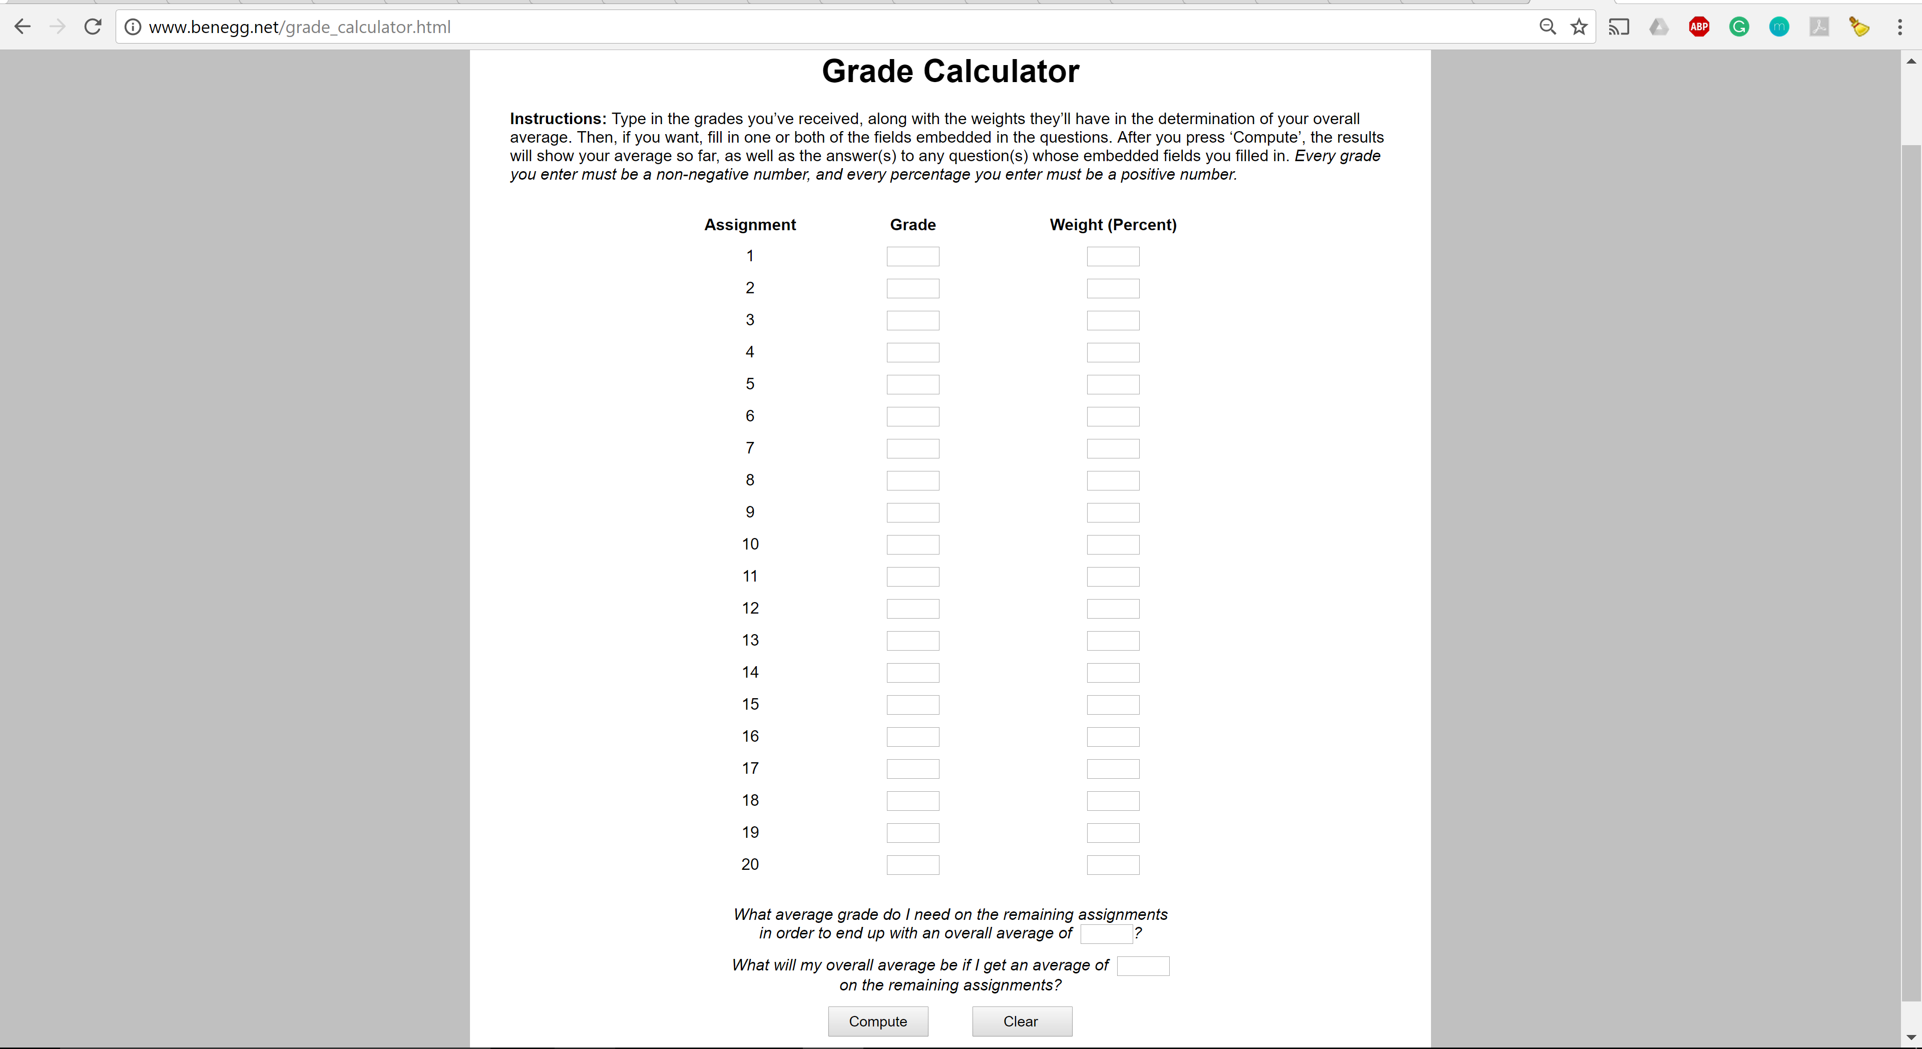
Similar Web Apps

Slide 5
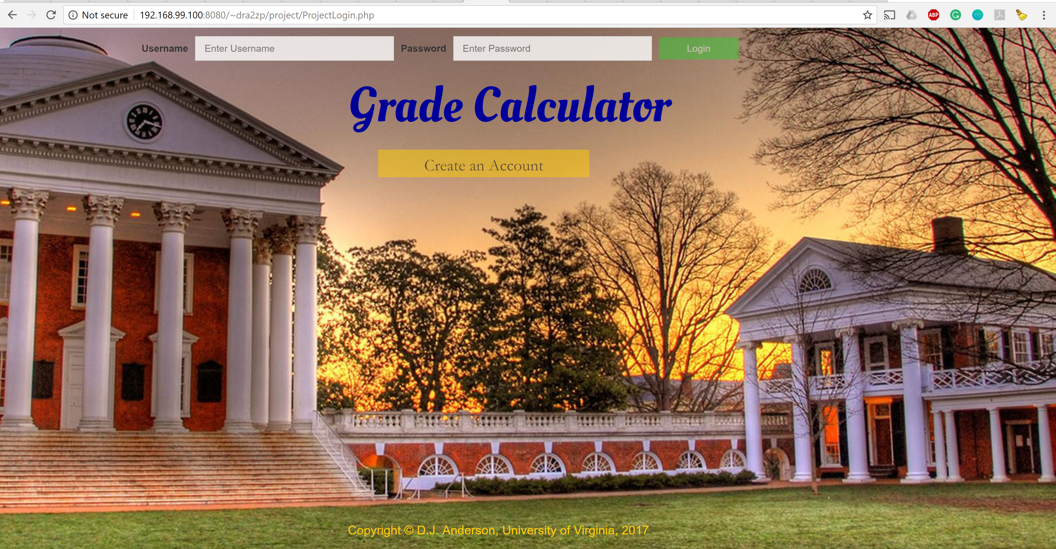
Login

Slide 6
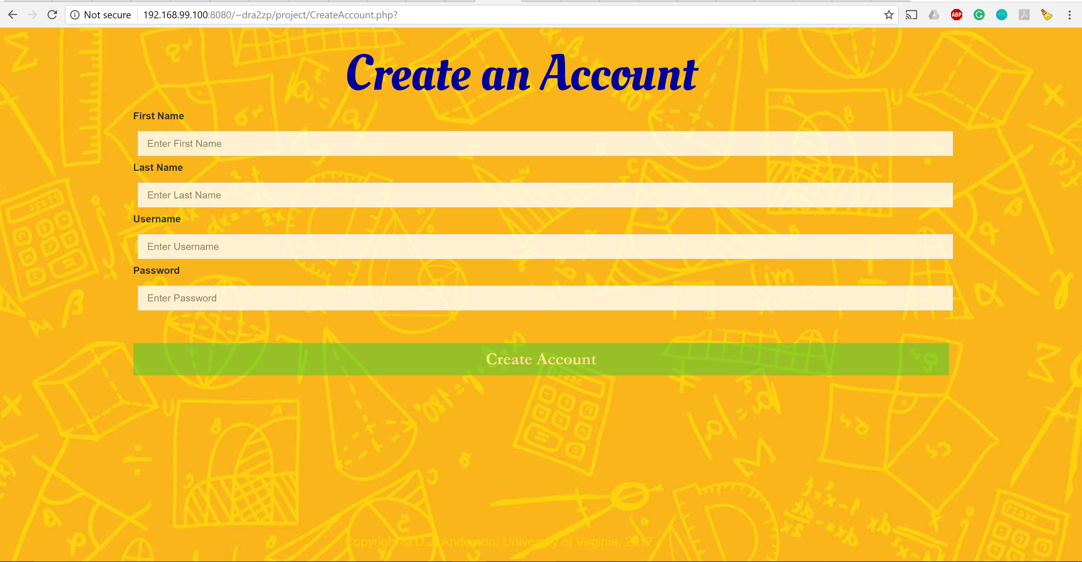
Create an Account

Slide 7
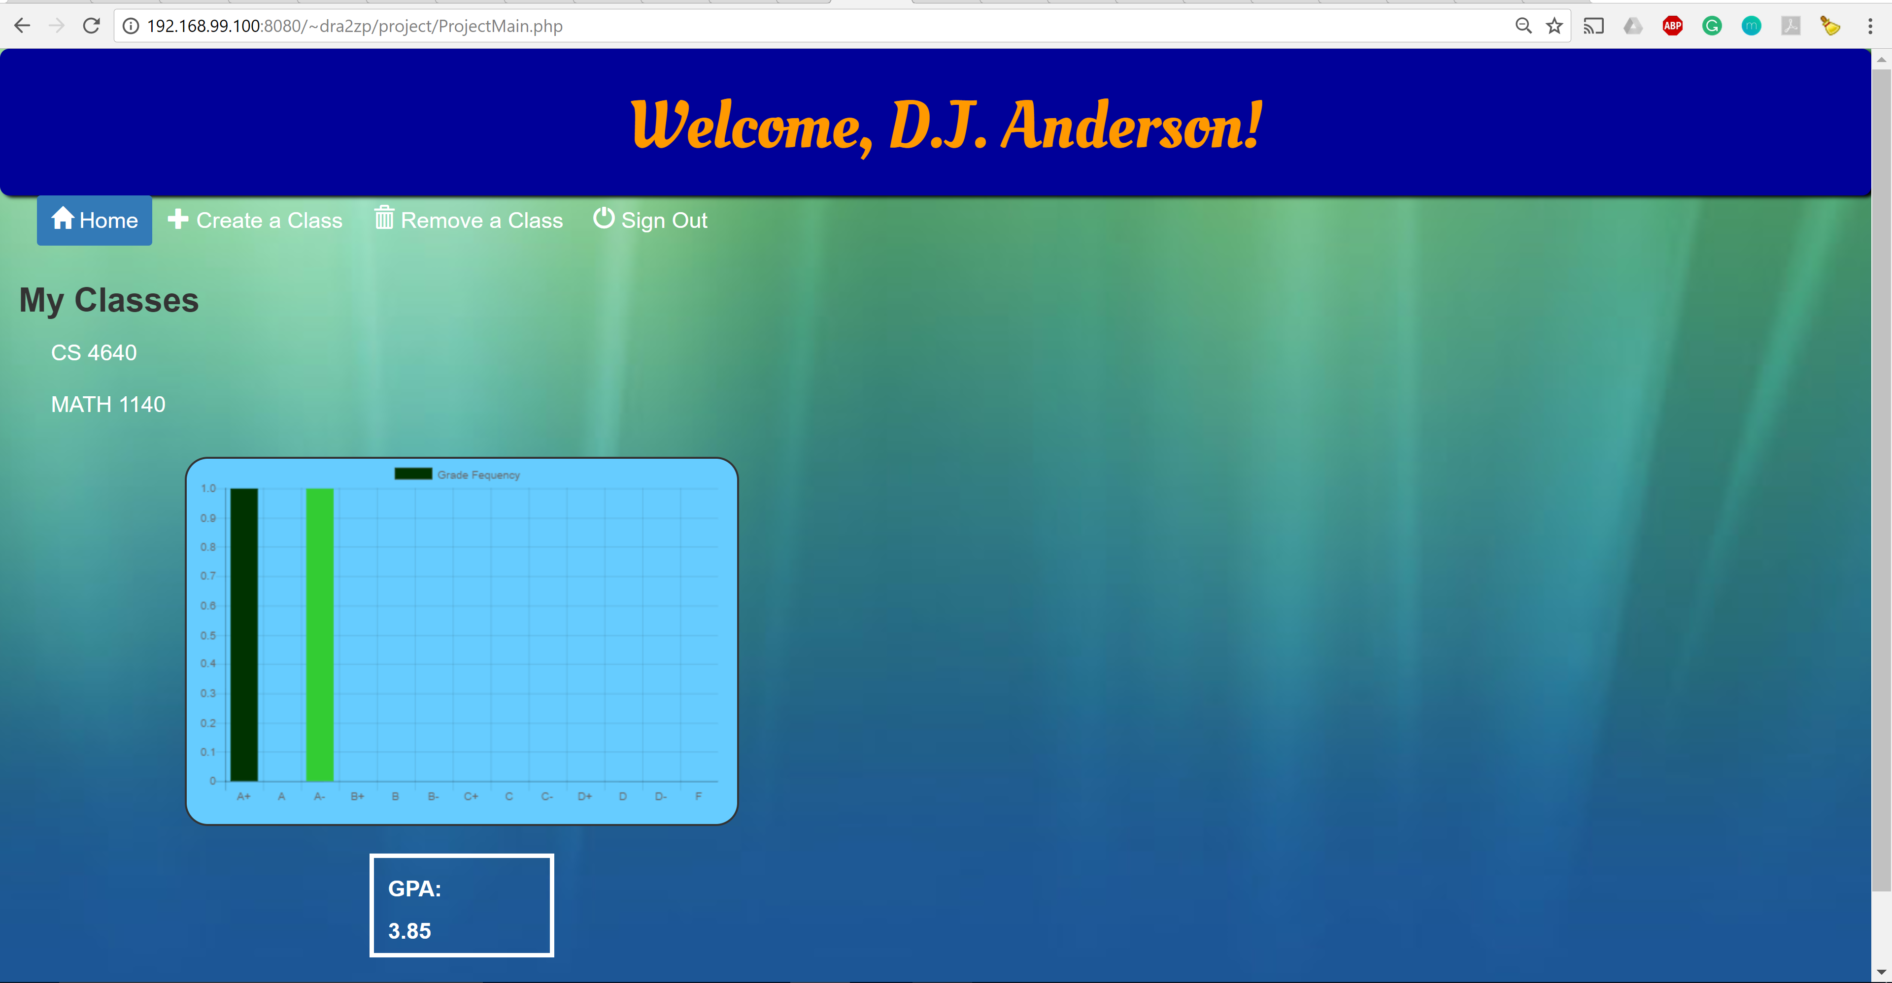
Main Page

Slide 8
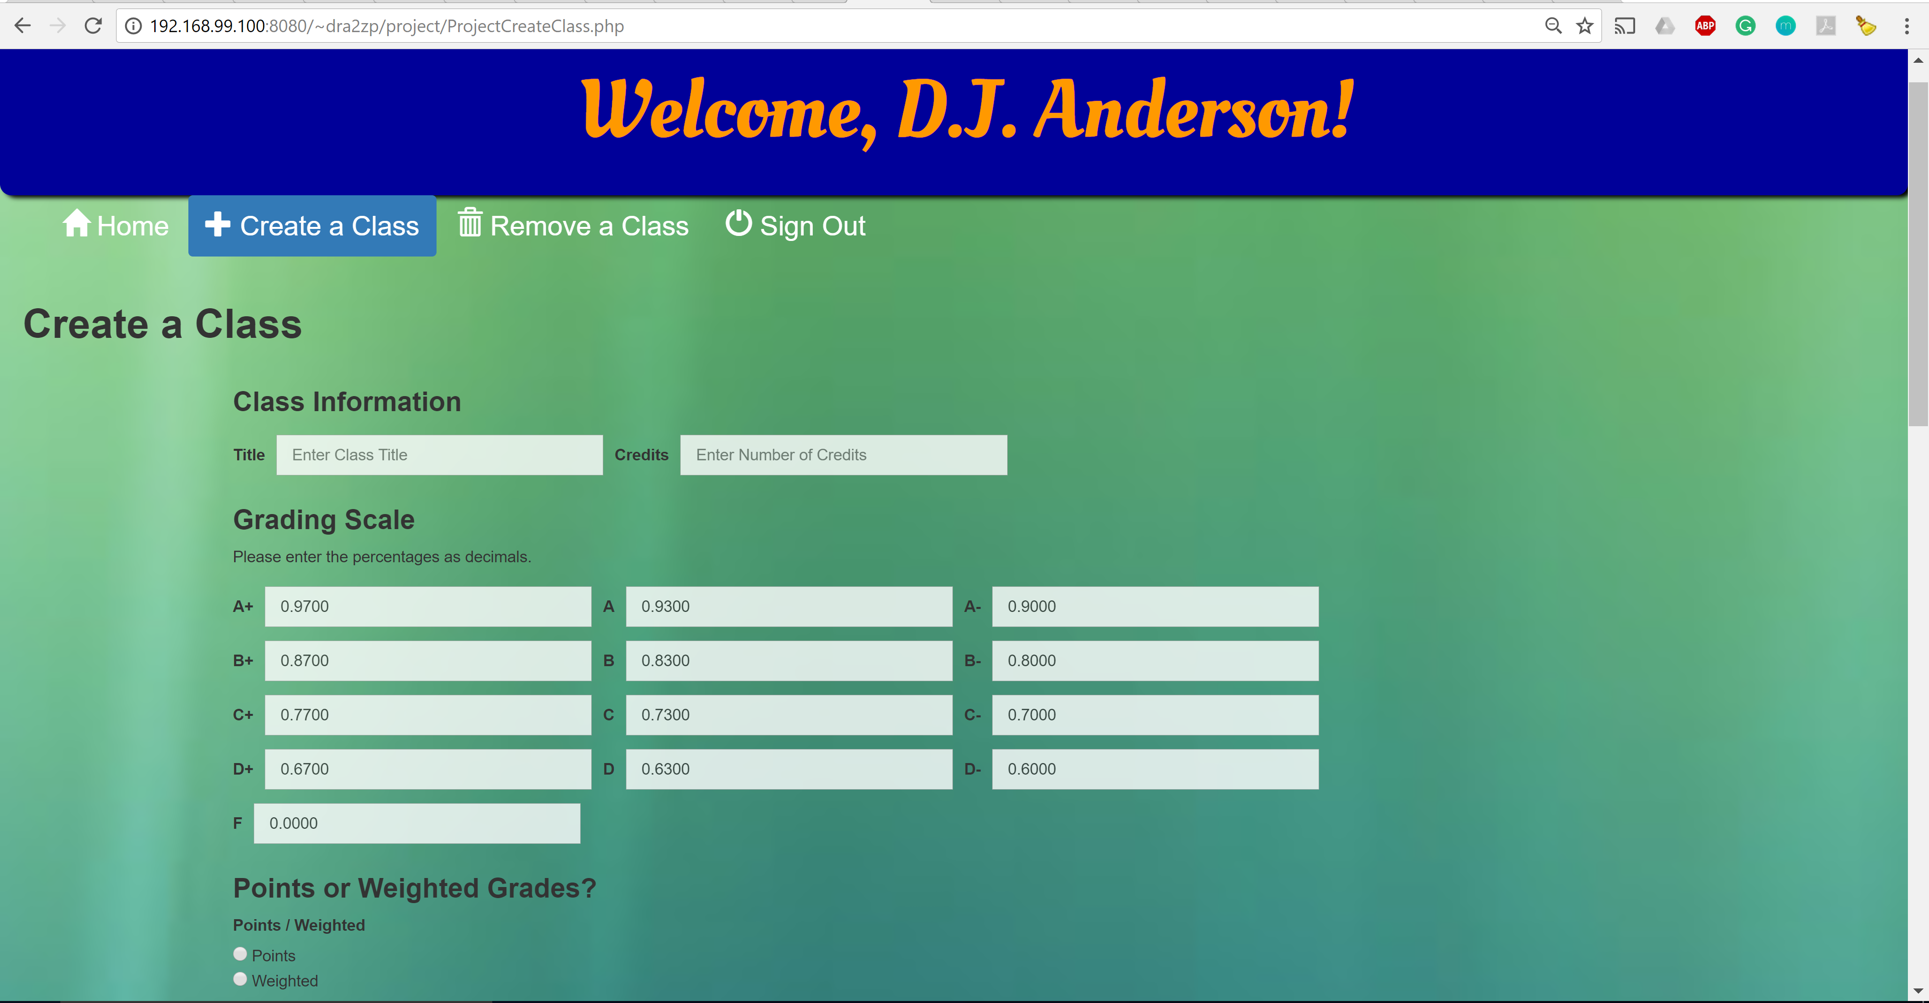
Create a Class

Slide 9
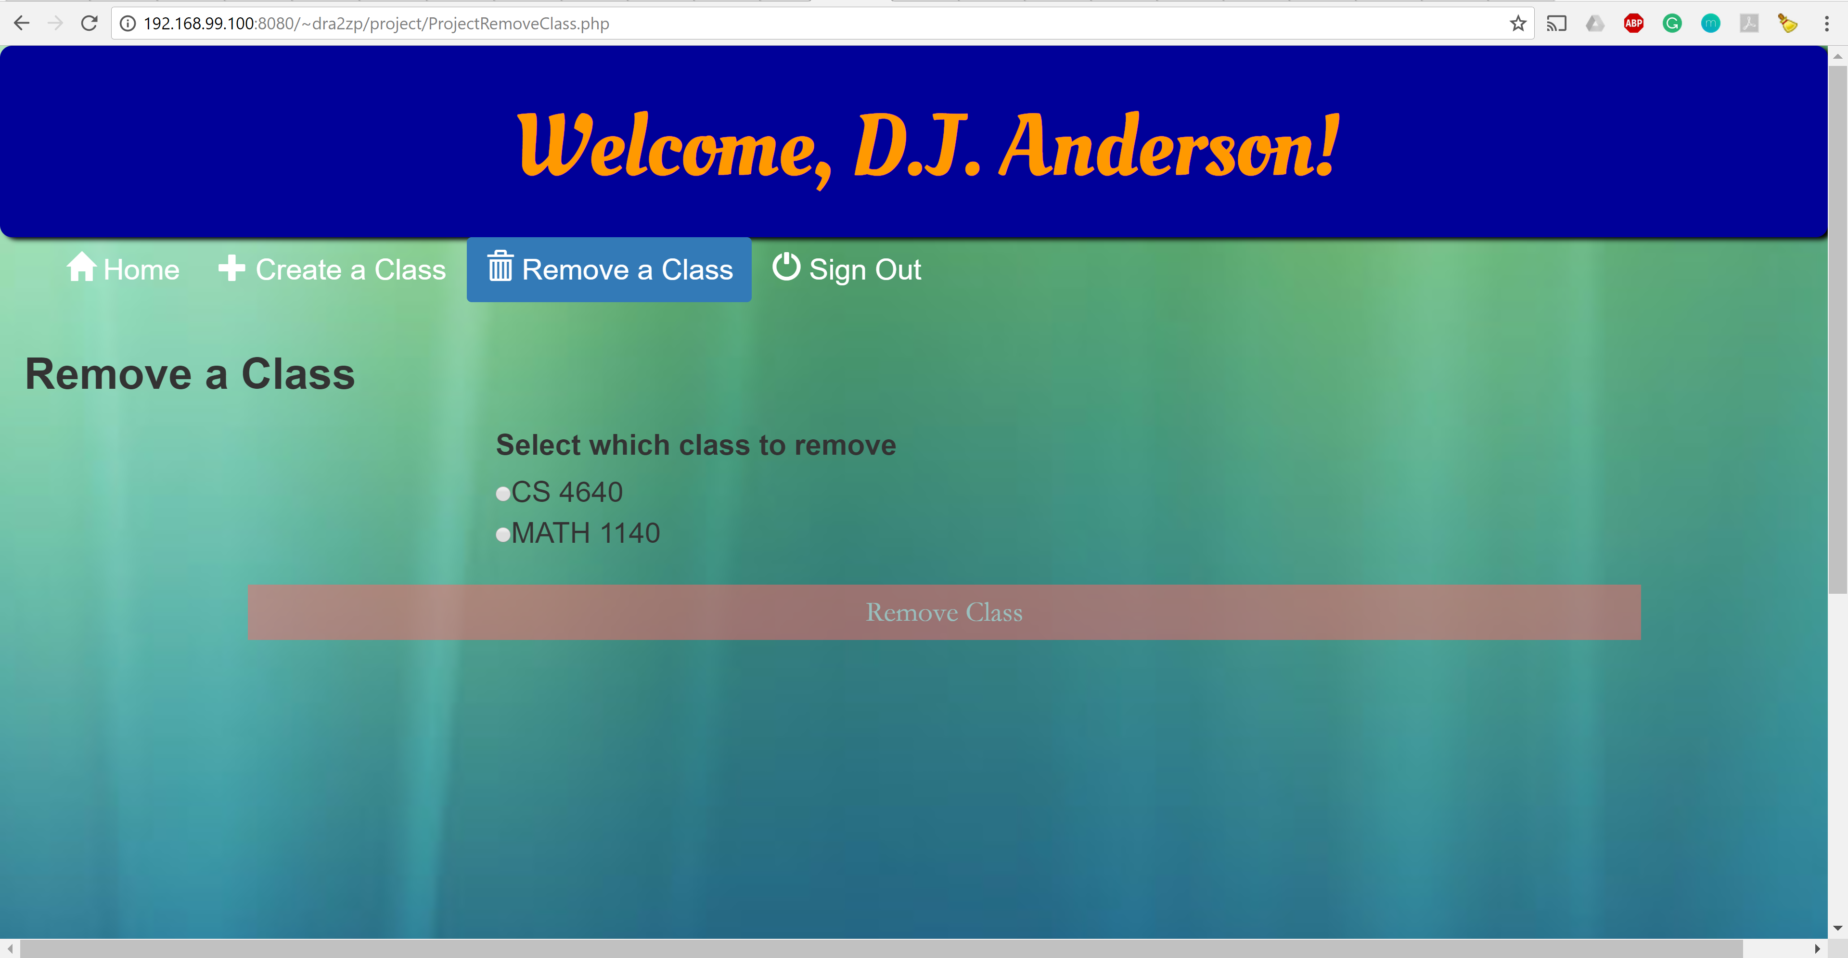
Remove a Class

Slide 10
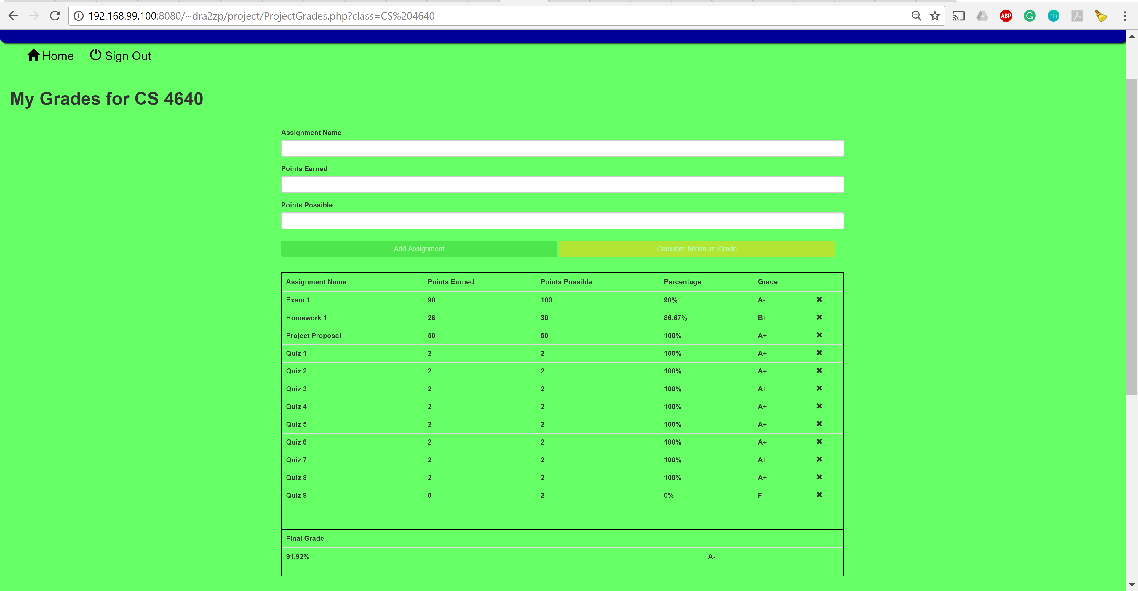
View Assignments & Grades

Slide 11
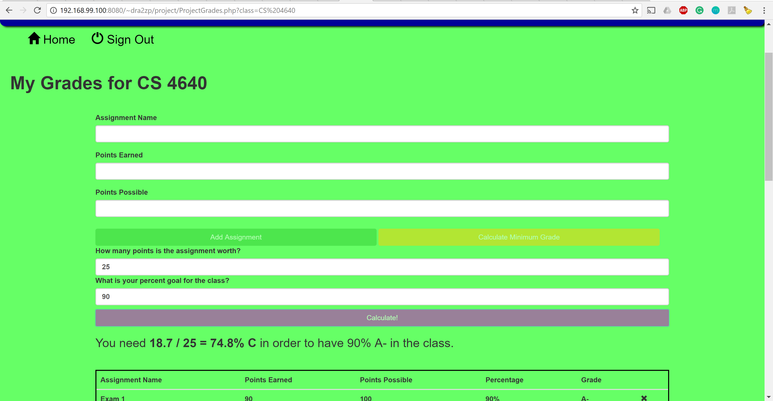
Calculate Minimum Grade

Slide 12
Any Questions?

